Slide 1


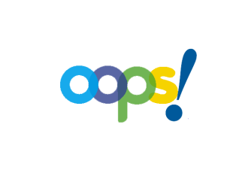

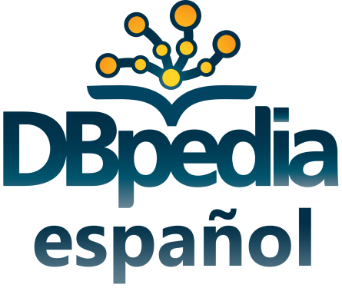


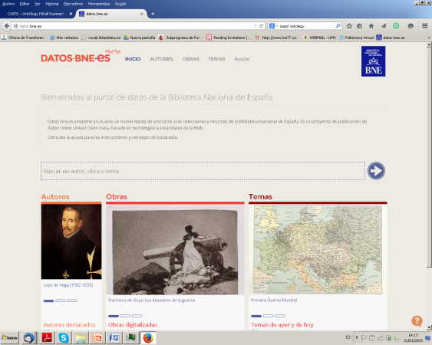
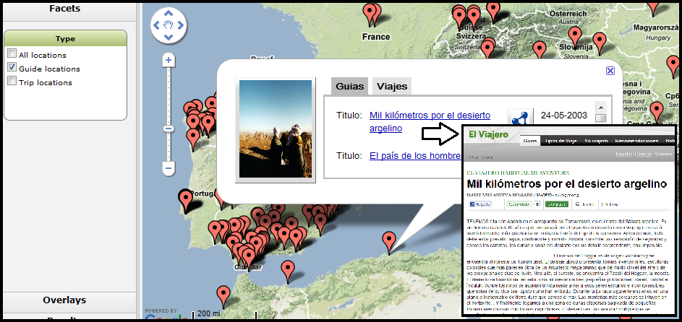
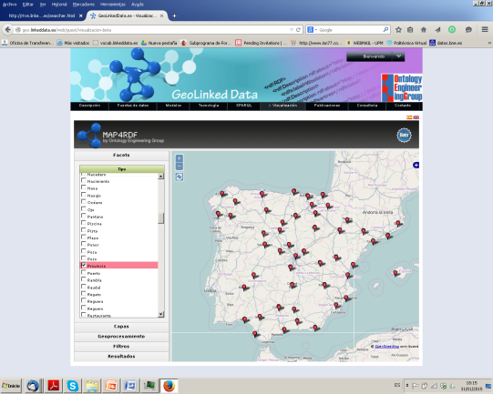
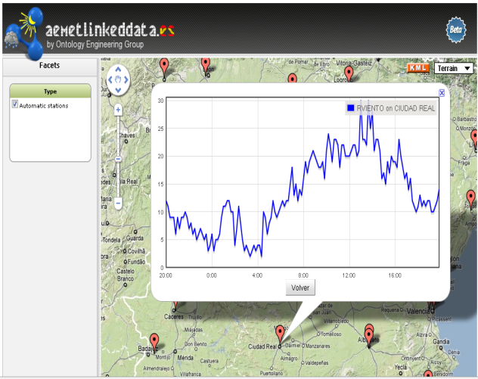
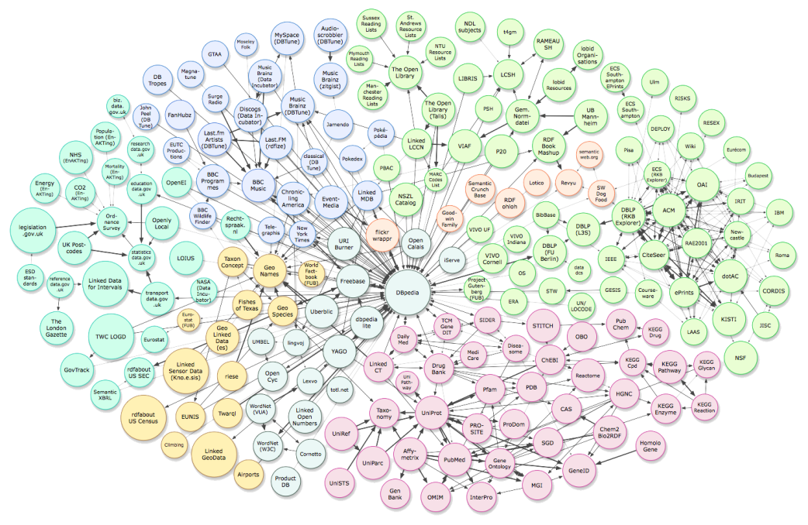
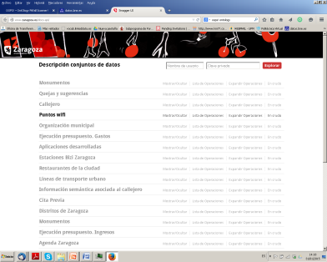
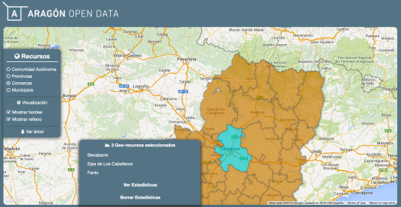
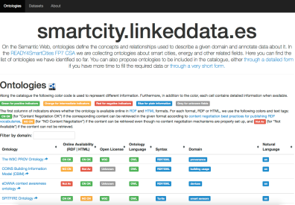
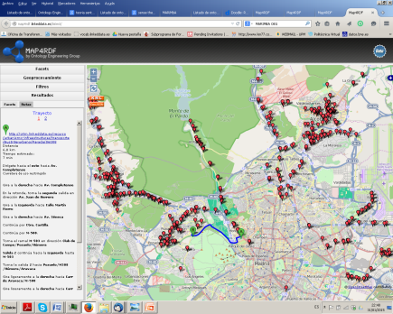
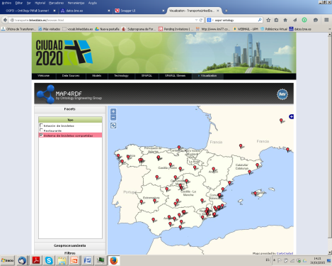
The Ontology Engineering Group, founded in 1995, is currently ranked in the 8th position in the UPM research groups ranking (more than 200 groups). The group is internationally recognized, with members belonging to European, Latin American and Asian countries; and multidisciplinary with formation in Informatics, Linguistics and Biology, among others.
Directors
Asunción Gómez-Pérez
Oscar Corcho
30+ researchers
150+ collaborators
30+ visitors
Team
Ontology Engineering
Semantic Web
Linked (Open) Data
Linguistic Engineering
Data Integration
Open Science
Topics
Projects
30+ European, 50+ national, 30+ private contracts
Publications
100+ journals, 350+ international conferences/book chapters, 7 books
R&D
Community
NeOn Methodology
Published ontologies
http://vocab.linkeddata.es
Ontology evaluation
http://oops.linkeddata.es
OnToology
http://ontoology.linkeddata.es
Standardization
25+ @ W3C, ISO, OASIS, AENOR
Events: 10+ Summer School on Semantic Web, 50+ workshops/tutorials
ODI Madrid Node
Services: DBpedia (es),
Spanish network of Open
Data and Smart Cities
Ontology Engineering
Open Data and Linked Data
Generation and linking
Publication
Visualization
morph-RDB
MIRROR
LDP4j
Culture (@BNE)
Blogs (@PRISA)
Geography
(@IGN)
Meteorology
(@AEMET)
geometry2RDF
shp2RDF
morph-streams
Sem4Tags
Smart cities (@Zaragoza)
Internet of things
(@CRTM, Bicycle system)
Marimba
map4RDF
geo REST service annotation
Collaboration with universities and companies
Leading researcher
Asunción Gómez-Pérez
asun@fi.upm.es

Slide 2
The Ontology Engineering Group is currently involved in several international and national projects under different funding grants and through contracts with private companies. There are open collaboration opportunities, contracts and fellowships in all of these projects.
International projects
SemDATA: Exchange of members among institutions funded under the International Research Staff Exchange Scheme (IRSES) of the EU Marie Curie Actions
DrInventor: Promoting Scientific Creativity by Utilising Web-based Research Objects
BigStorage: Storage-based Convergence between HPC and Cloud to handle Big Data
KOPAR: Knowledge Publishing, Acquisition and Representation
SIMON: asSIsted MobIlity for Older aNd impaired users
3cixty: A Platform for Apps and Services Offering Comprehensive Views for City Visitors
Stars4All: A Collective Awareness Platform for Promoting Dark Skies in Europe
Vicinity: Open virtual neighborhood network to connect intelligent buildings and smart objects
SlideWiki: Large-scale pilots for collaborative OpenCourseWare authoring, multiplatform delivery and Learning Analytics
MOBILE-AGE: Open government data, mobile technology, and the provision of public services in relation to Europe’s elderly population
Clarity: Champion e-government appLications to increAse tRust, accountability and TransparencY in public services
SAREF extension: Specialist Task Force on Maintenance & Evolution of SAREF Reference Ontology
National projects
MINETUR: Generation and exploitation of probabilistic topic models based on large corpus of technology patents
CyL: Public tender for producing mathematical models in the context of population segmentation on the Castilla y León region
BNE: Advanced services for including new features and improvements for the Spanish national library portal (http://datos.bne.es)
K-Dictionaries: Consultancy on Word Sense Disambiguation of lexicographic information for K Dictionaries and Semantic Web Company
4V (Volumen, Velocidad, Variedad y Validez): Innovative data management techniques
ReTeLe network: Red de Recursos de Tecnologías para la Lengua
DACI network: Red Temática de Datos Abiertos en las Ciudades Inteligentes
LPS BIGGER: Big data products in real business and research environments
esTextAnalytics: Text Analytics services for exploiting the Spanish chapter of DBpedia
Leading researcher
Asunción Gómez-Pérez
asun@fi.upm.es

